Slide 1

Retail Banking System
MFPE (POD - 6) GN22CDEJFS008
Team Members
Mentor :
Susha Raghunath
Purushottam Kumar (2144501)
Kapil Gupta (2130972 )
Chinnaiah Nagarajan (2143540)
Shivam Tripathi (2143326)
Trainer :
Venkata Krishna Kumar Maddela
Coach :
Akilandeshwari Subramani

Slide 2
Introduction
The Retail Banking System provides Microservice Architecture
based software solution.
It provides high Availability operations for their client & bank employees without disruption.
Different Microservices like “Account”, ”Customer” and “Transaction” etc. are combined together to perform together as a Uniﬁed application.

Slide 3
Microservices
Separating the different functionalities of a application into modules is called a microservice.
In the simplest form, they help build an application as a suite of small services, each running in its own process and are independently deployable.​
Internal operations are a “black box”, accessible to external programs only via API.

Slide 4
Why Microservices
Each service is independent from one another and can be developed in any language.
Can build Robust applications.
Microservices communicate with other microservices via Rest API.
Fault Tolerant Applications can be built .
Each service can have it’s own database. One module can have SQL, another one can have mongoDB and so on.

Slide 5
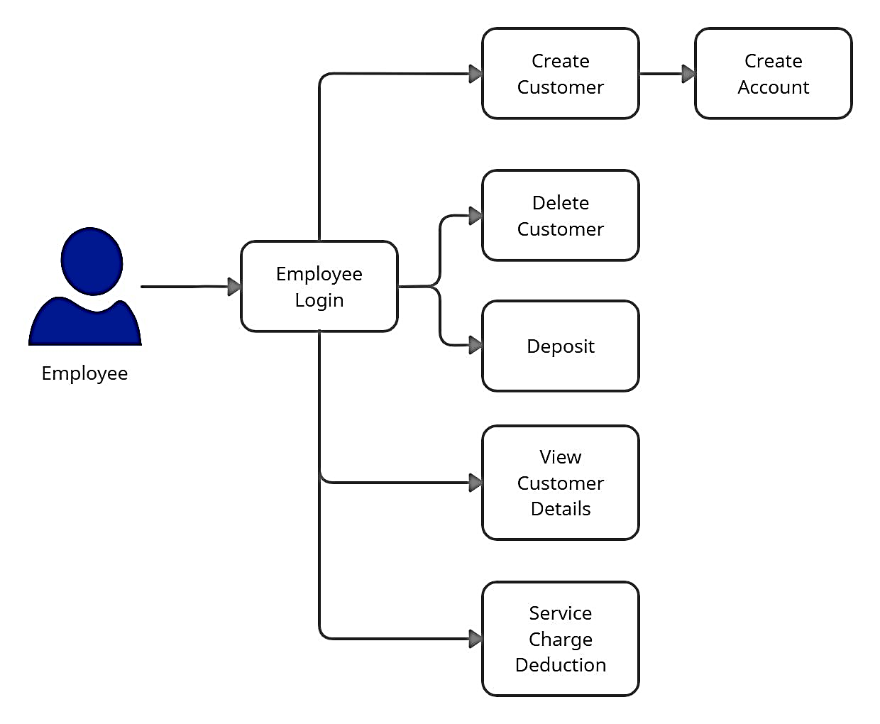
Architecture Diagram for Employee

Slide 6
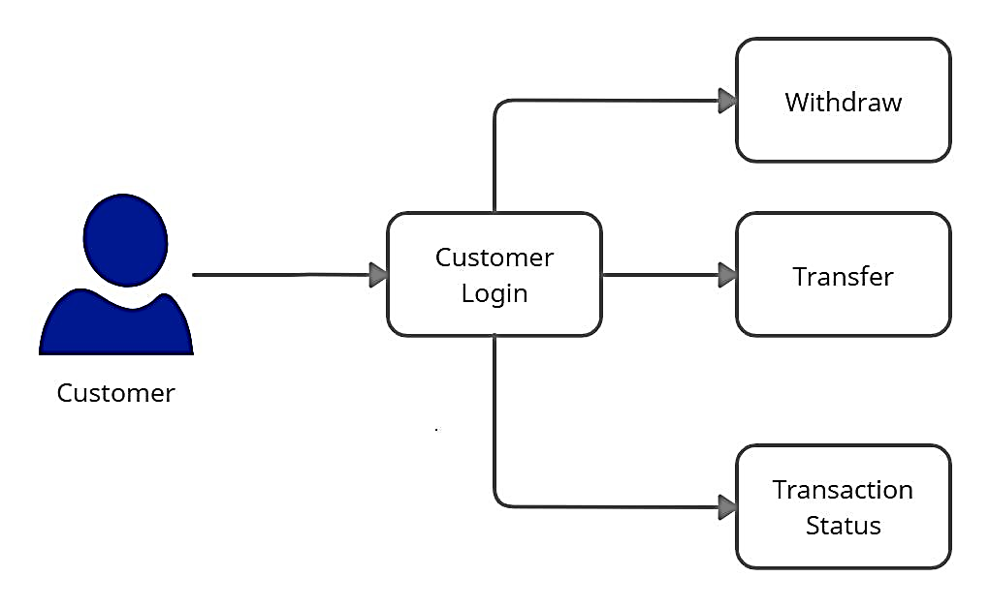
Architecture Diagram for Customer
Transaction Details

Slide 7


Use Case Diagram
Bank System
Login
Create Account
View Account Statement
<<includes>>
<<includes>>
Customer
Create Customer
Bank Employee
Transaction
Display Customer

Slide 8
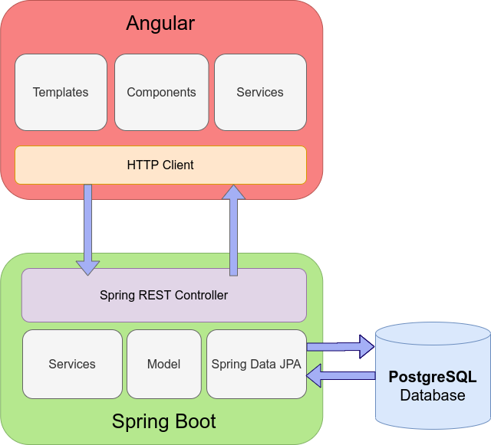
Client - Server Architecture
DB

Slide 9
Technologies Used
Front End : Angular 8
Backend : Java, Spring Boot, Restful-Services
Database : H2 - database
Tools : Spring Tool Suite, Swagger, Eclemma, Postman, AWS

Slide 10
Working Microservices:
Authorization microservice
Customer microservice
Account microservice
Transaction microservice
Rules microservice

Slide 11
Authentication Microservice
Authentication Microservice will perform operations like:
Login &
Logout
Authentication will provide the JWT token after user’s validation.
Providing the authorisation based on user’s login

Slide 12
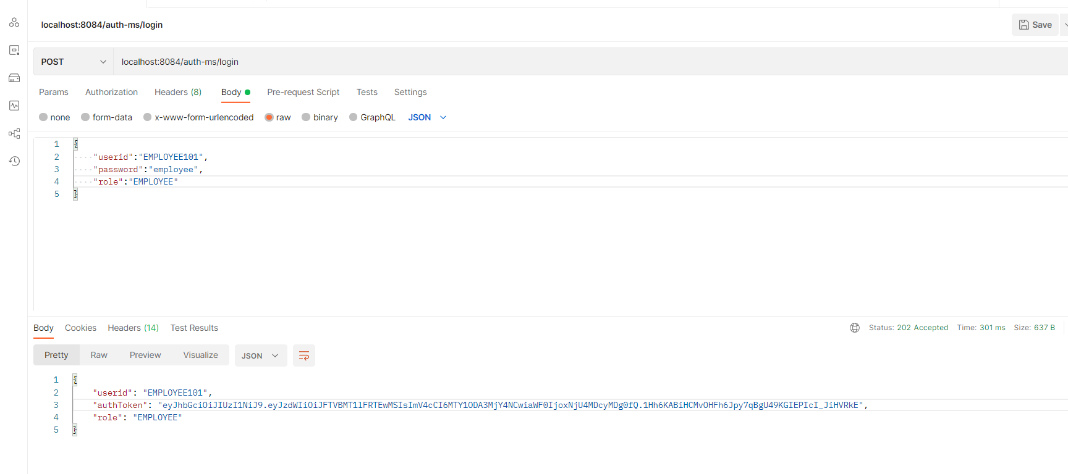
Authorization Microservice - Sample request

Slide 13
Customer Microservice
Customer microservice will performs operations like :
Creation and Updation of Customer Details
Fetching Customer Details
Deletion of Customer
It even interacts with authentication and account microservices for the purpose of sharing details.

Slide 14
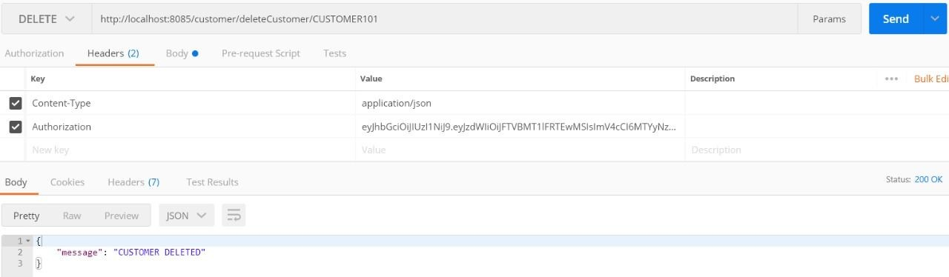
Customer Microservice - Sample request

Slide 15
Account Microservice
Account Microservice will perform following operations:
Customer Account Creation
Fetching Account Details for Each Customer
Deposit and Withdraw from customer’s account.
Interacts with transaction microservice for validating the account details and transferring the amount.

Slide 16
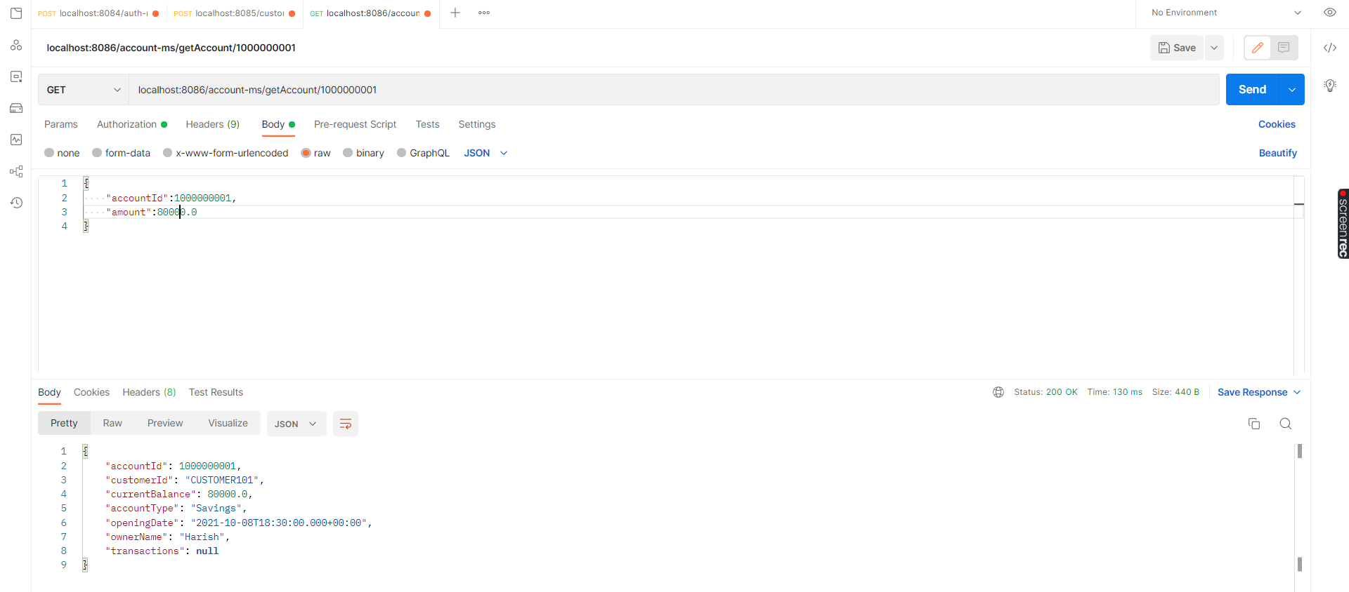
Account Microservice - Sample request

Slide 17
Transaction Microservice
Transaction Microservices will perform operations like:
Fetching transactions history for individual account.
Validating the account details for individual customer.
Checks minimum balance for the transfer and withdraw account.
Inserting each entry of transaction after transfer and withdrawal.
Transactions microservice will interact with Account microservice to actually complete the transactions within the accounts.

Slide 18
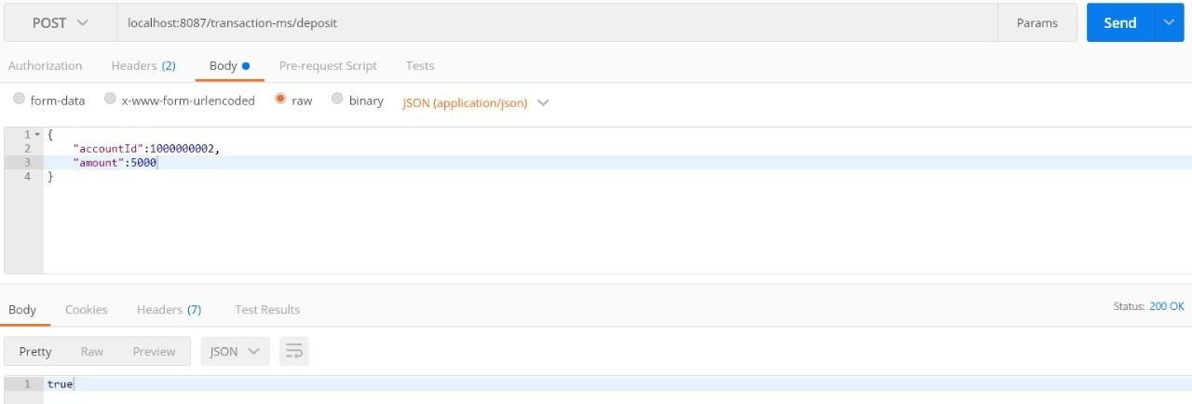
Transaction Microservice - Sample request

Slide 19
Rules Microservice
Rules Microservice will be responsible for evaluating rules:
Minimum Account Balance &
Service Charge Deduction
Interacts with account and transaction microservice for checking rules while
transferring and withdrawing from source account.

Slide 20
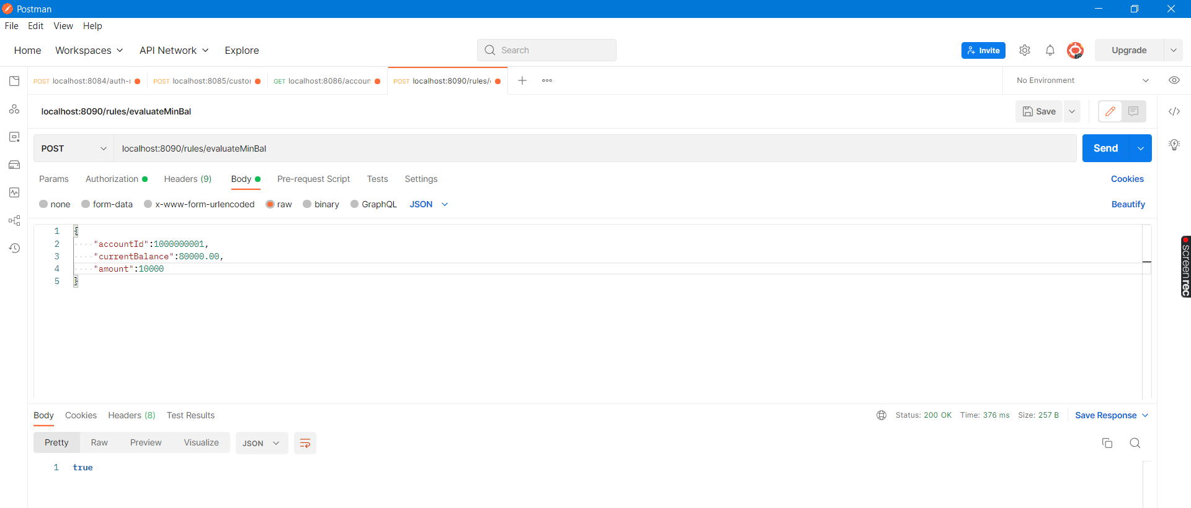
Rules Microservice - Sample request

Slide 21
Front-End Snapshots

Slide 22
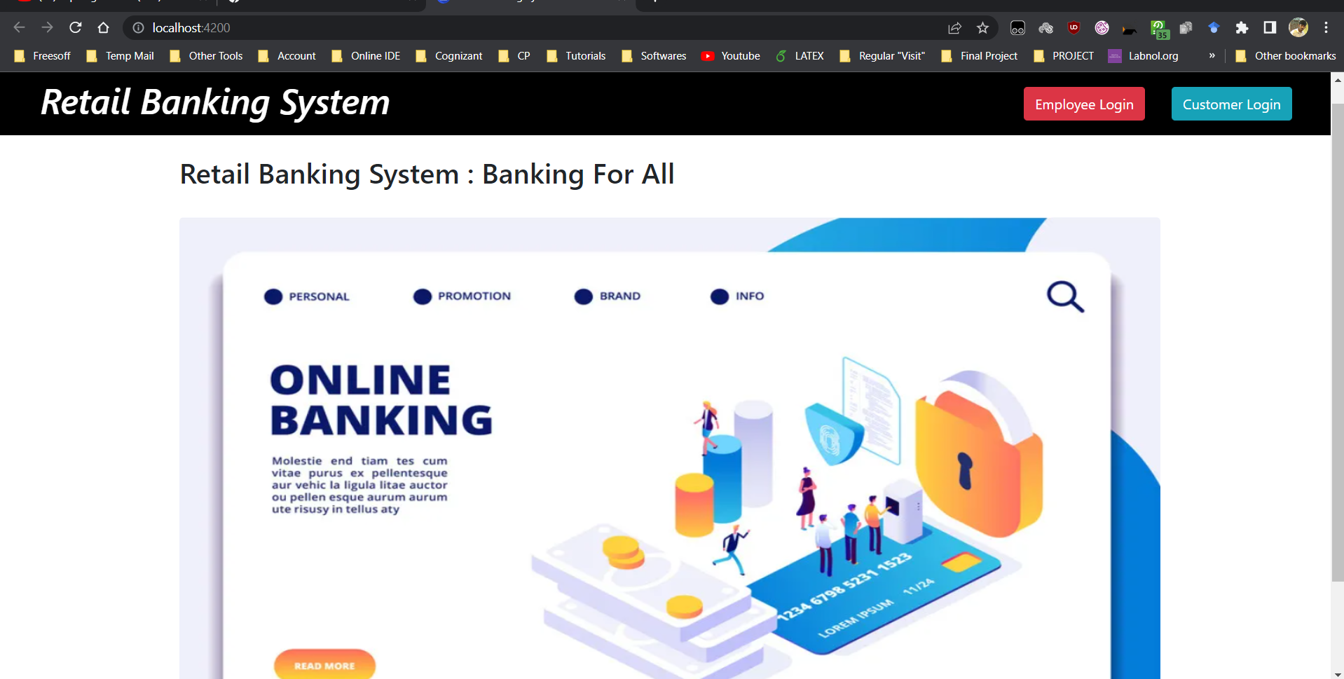

Slide 23
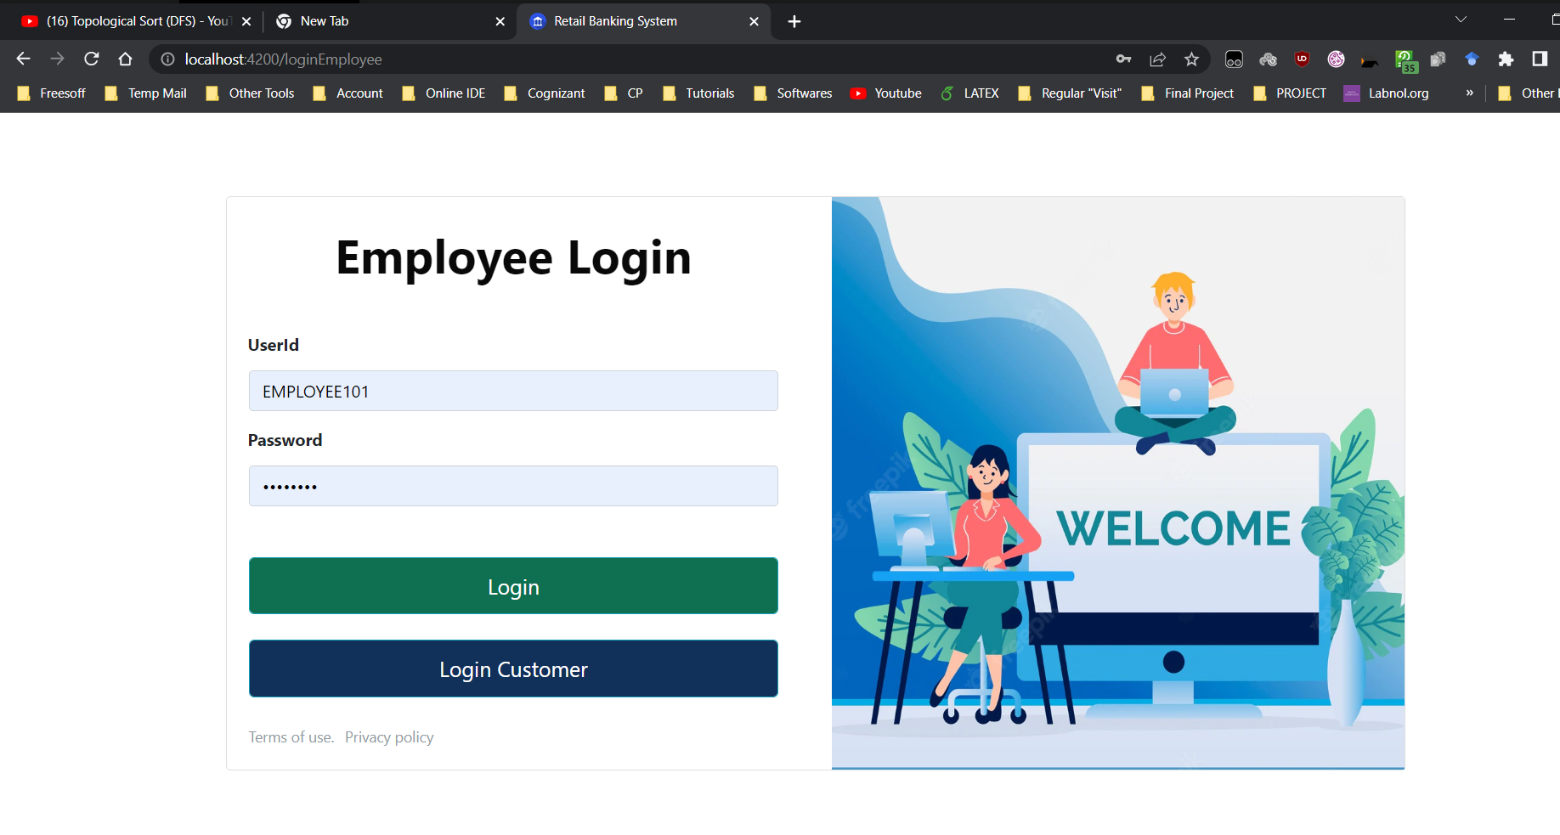

Slide 24
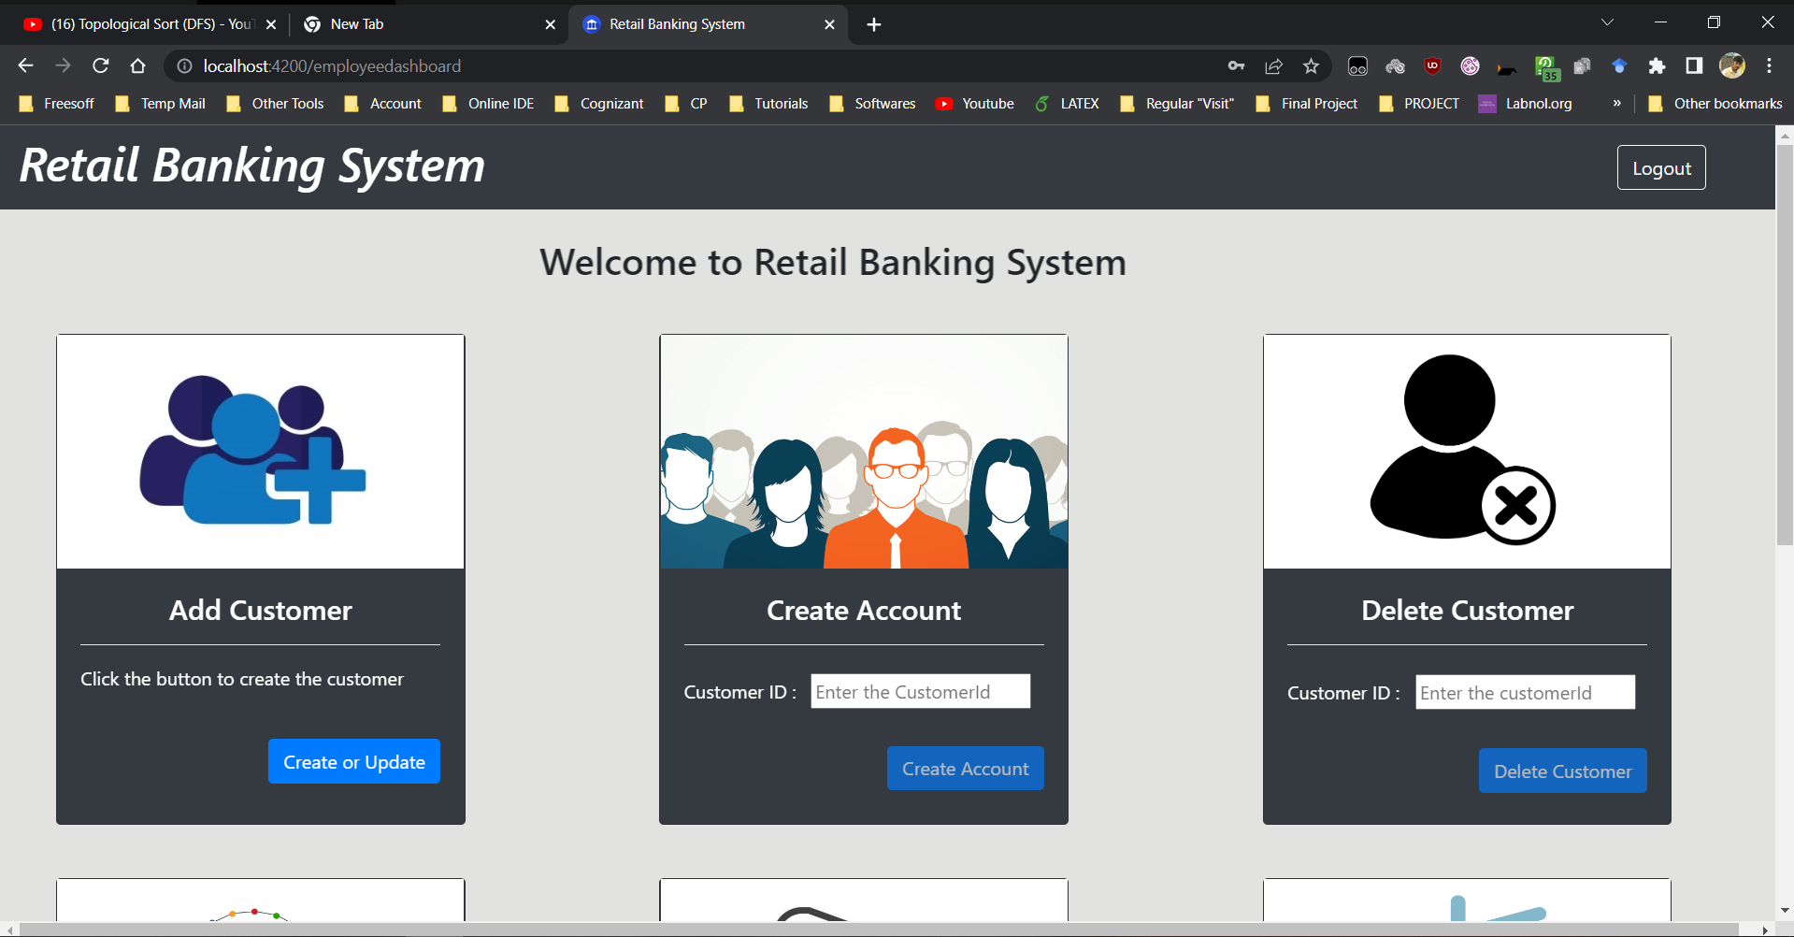

Slide 25
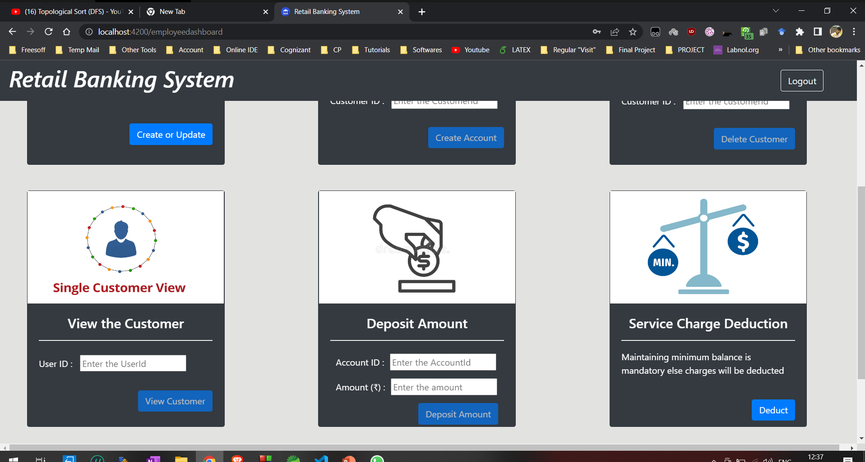

Slide 26
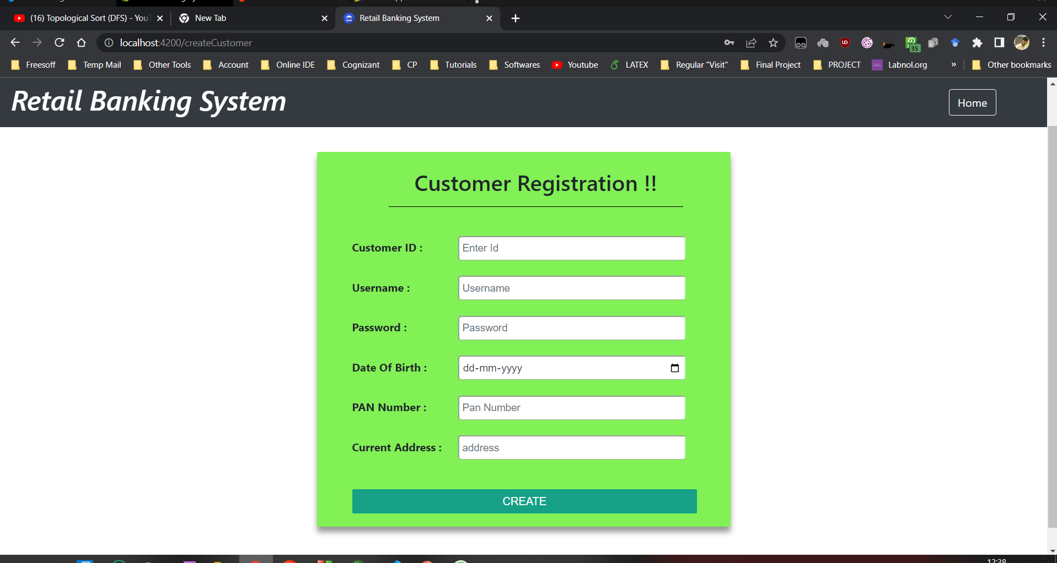

Slide 27
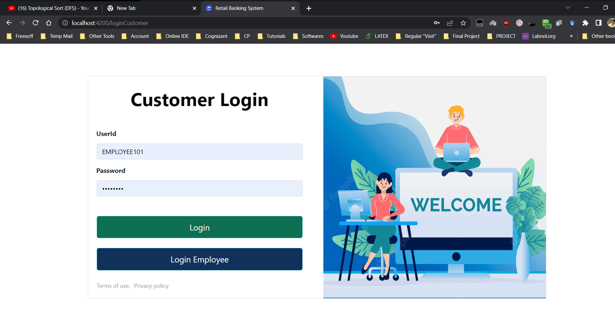

Slide 28
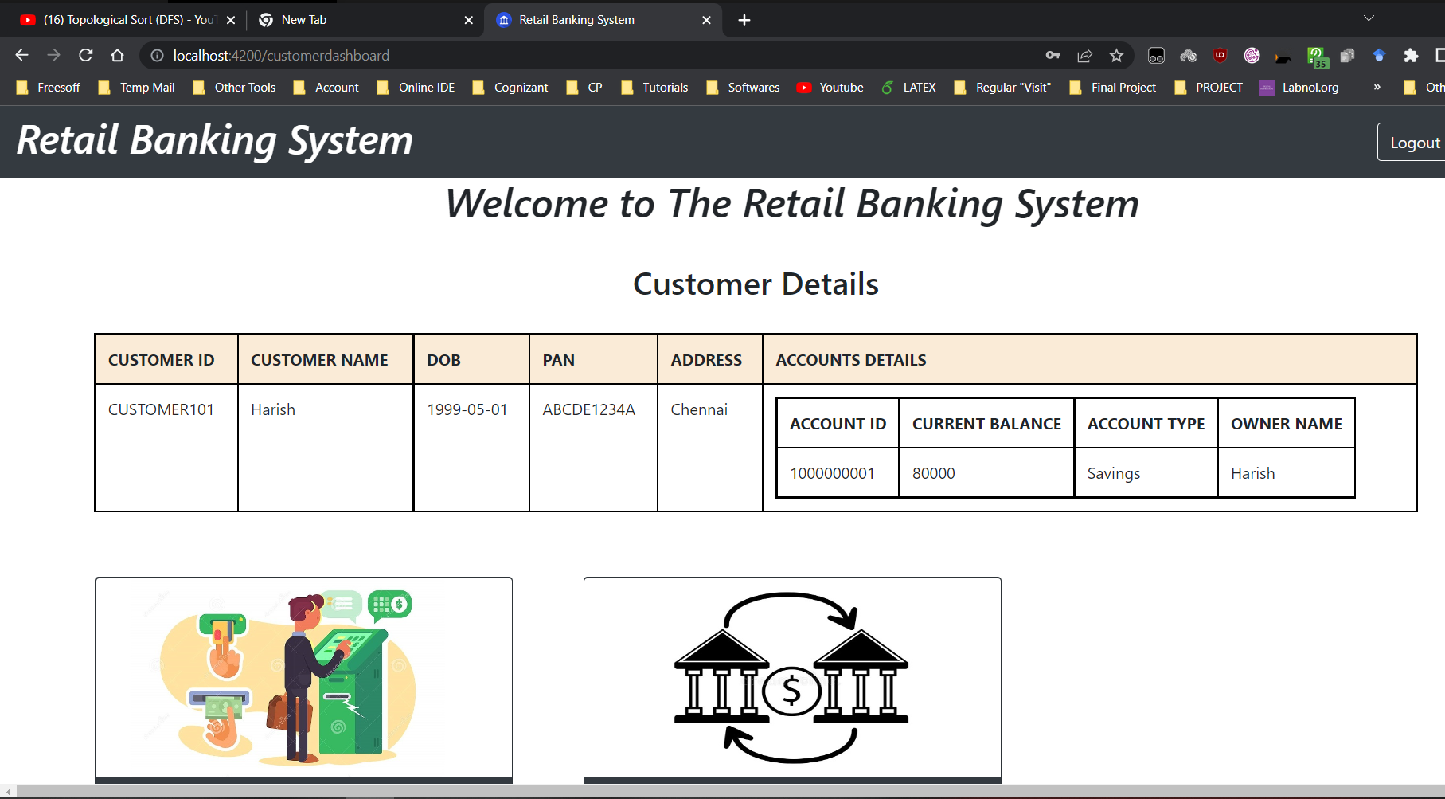

Slide 29
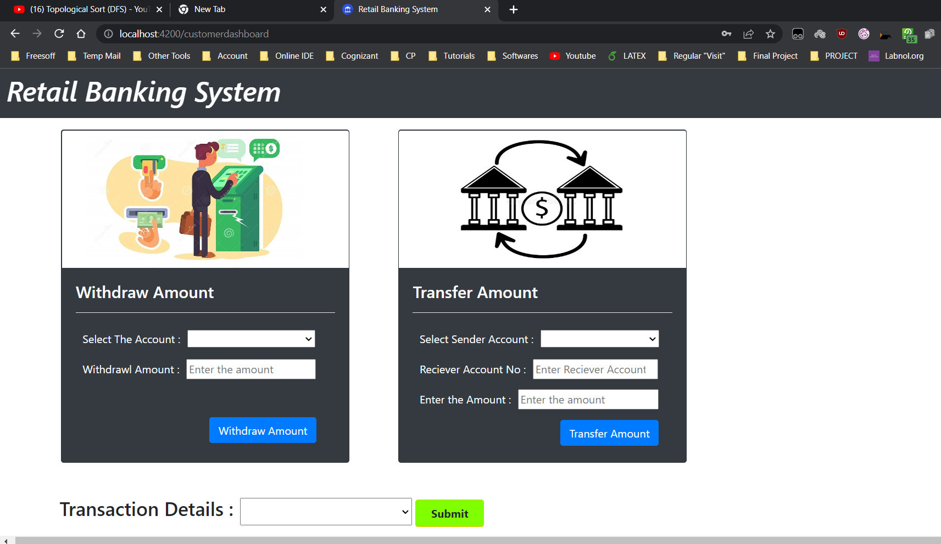

Slide 30
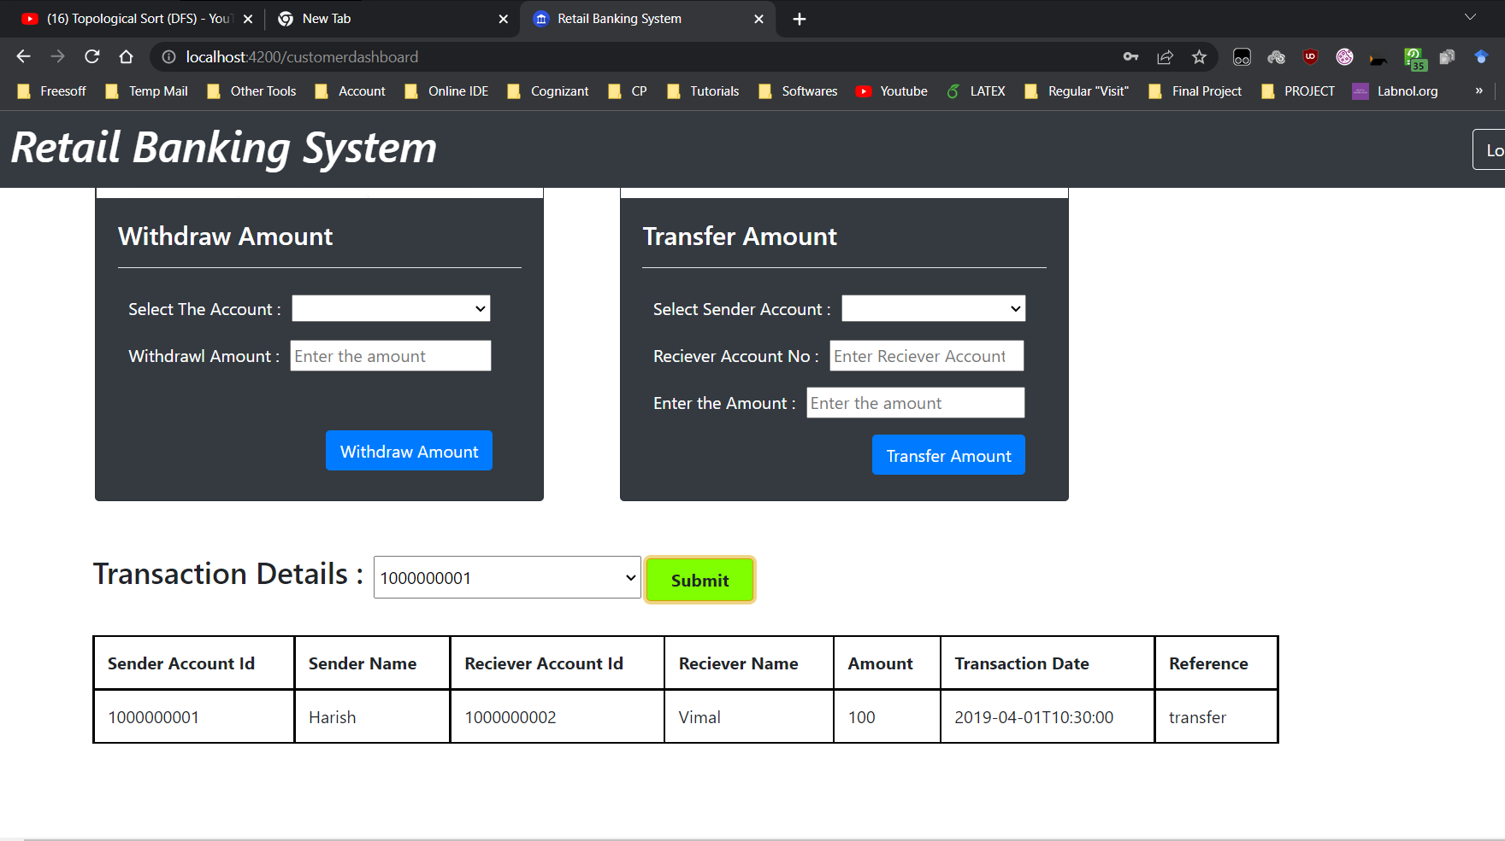

Slide 31
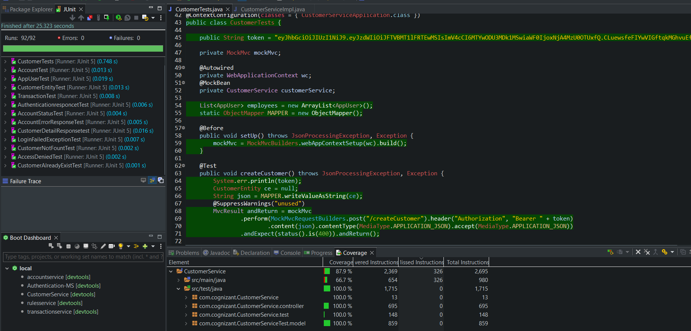
Unit testing and Code Coverage

Slide 32
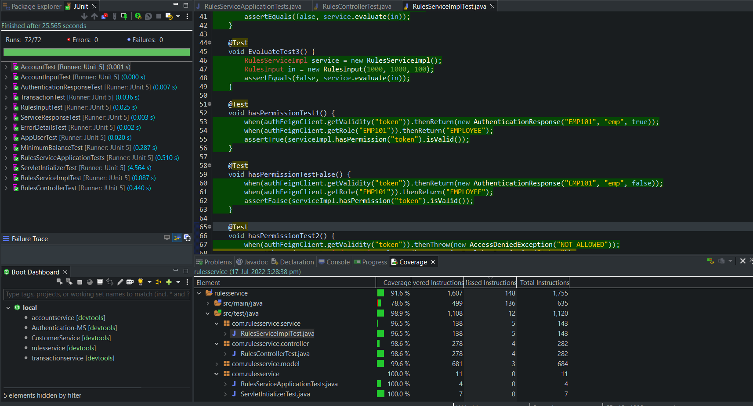
Unit testing and Code Coverage

Slide 33
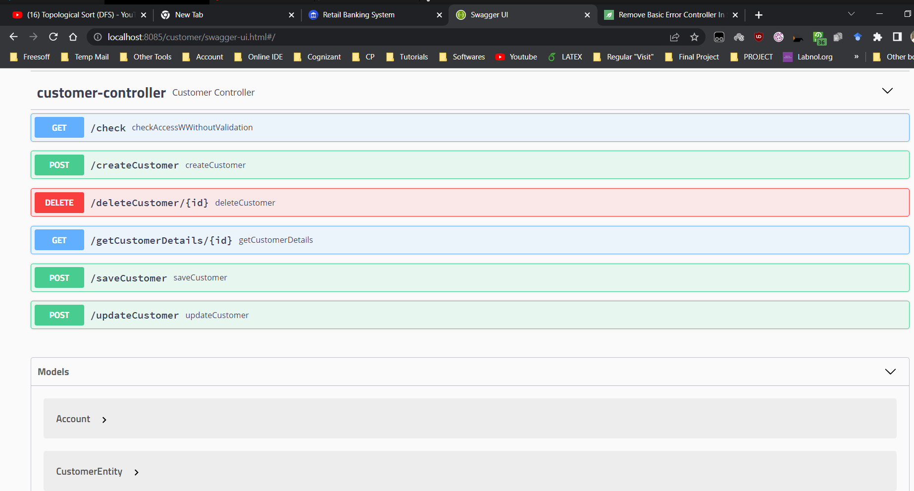

Slide 34
Thank You ...!

